Slide 1

UCAS Process/Student Finance
Savannah Robinson
Future Students Office

Slide 2
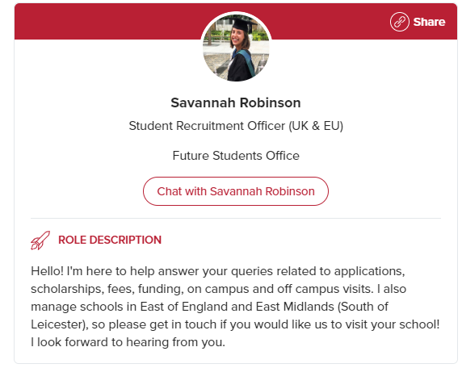
Thank you for joining!
A bit about me
Savannah Robinson
Cumbria
Drama and Theatre Studies
Graduated 2017
www.le.ac.uk/chat

Slide 3

Today
What we will look at today
Application timeline
Application Process
Personal Statements
Student Finance
Q&A

Slide 4

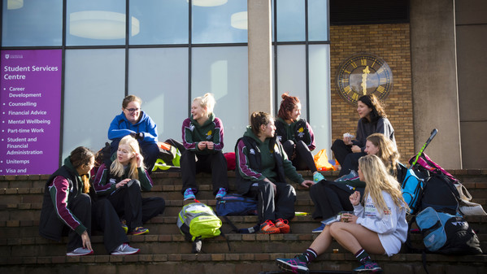
Application Process

Slide 5
The Application Timeline
Now- October
October-January
January-March
March-May
May-July
August
September-October
Apply
15th October- Oxbridge, Medicine, Dentistry, Vet Science
26th January-
All other applications
You decide
Conditional Firm
Conditional Insurance
Reject
Offer Holder days
Results Day
Clearing
Adjustment
Research your courses and universities
Writing the Personal Statement
Offers:
Conditional
Unconditional
Interview
Reject
UCAS Extra
Revise for your exams and take them
Apply to accommodation
Start University

Slide 6

The Basics
Submitted via UCAS
Also advice on apprenticeships, gap years, and internships
Up to 5 choices
4 for Medicine, Dentistry and Vet Science + 1 different choice
1 application
Teachers check through before submission
The Application Process

Slide 7
Application Process
Section One
Personal Details
Section Two
Course Choices
(five options)
Section Three
Education History
Section Four
Employment History
Section Five
Personal Statement
Section Six
Reference
UCAS Application

Slide 8


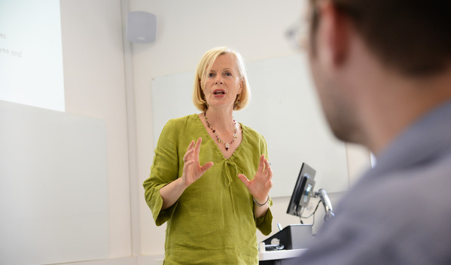
Application Process
Personal Statement
4,000 character limit
One statement for all applications
Similarity checked by UCAS systems
To convince an admissions tutor to make an offer to study one of their courses
Motivated, well rounded, skills and achievements
75% Academic, 25% Personal
Work Experience if required
ABC Method
Proofread and start early!

Slide 9
How can you help support your child with applications?
Make sure they hit the internal deadline
Help with proof reading
Remind them of any skills and achievements they might have
Encourage them to talk to staff
Encourage them to look at independent research (MOOCS, Books, Subject Societies)
Take them to open days/offer holder days/campus tours
How can you help?

Slide 10




Application Process
Key Terms
Conditional- Meet conditions
Unconditional- Guaranteed an offer
Interview- Go for an Interview
Decline- Declined a place
Check UCAS Track
UCAS Extra if all declined

Slide 11
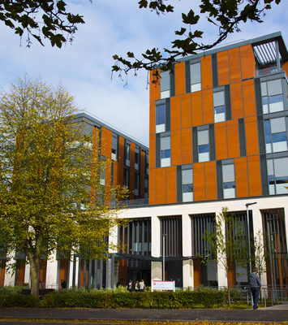
The Application Process
You decide
Firm Choice
Insurance Choice
Decline
Key Terms
Good idea to make your insurance choice have lower conditions

Slide 12

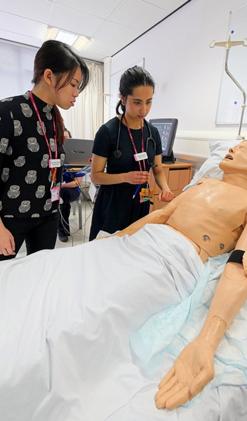
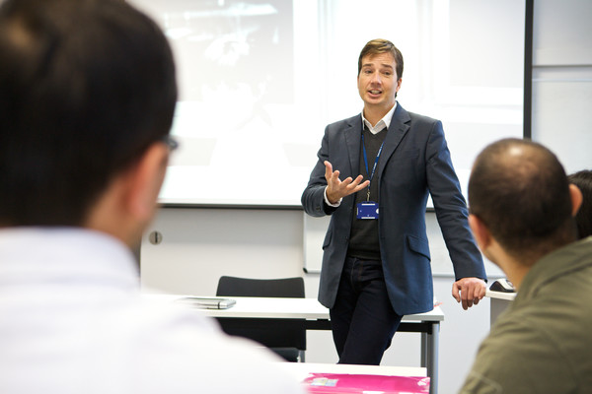
Results Day
Top Tips
Be in the country
Make a list of clearing options before
Check UCAS Track
Talk to teachers
Apply to accommodation if you haven’t already
If you don’t get into your first choice it’s not the end of the world
Remember resits are a thing
Stock the fridge with chocolate
Make a check list of all the things you have to do before University

Slide 13

Student Finance

Slide 14

Mythbuster!

Slide 15


You have to put a deposit down on your student loan.
True or false?

Slide 16
Student finance is available for a range of qualifications including HNCs and HNDs.
True or false?

Slide 17
Student loans do not show up on your credit report once you have graduated.
True or false?

Slide 18

One myth I want to debunk before we go any further is that money or finances should never be a barrier to going to university. Moreover, student loans do not affect your credit rating and repayments will not leave you poor once you graduate.

Slide 19

How Student Finance Works

Slide 20
Eligibility
Settled status – can live in the UK without any Home Office restriction
Ordinarily resident in England on the first day of the first academic year of their course
Been living in the UK for the three years immediately prior to this date
Am I eligible?

Slide 21
If you study full-time, you may be eligible for student finance if your course is in the UK and you take a recognised higher education course in the UK, including;
A first degree, for example BA, BSc or BEd or an integrated Master’s Degree
A Foundation Degree, Higher National Certificate (HNC) or Higher National Diploma (HND)
Eligible second qualifications e.g. PCGE
Full time undergraduate

Slide 22

Eligible full-time students may be able to apply for and receive financial support from SFE including;
Tuition Fee Loan – this is up to £9250 and is paid directly to the university
Maintenance Loan – this is for your living costs and changes dependent upon your household income
Additional Support Grants – these include Disabled Students Allowance, Childcare Grants, Parents Learning Allowance and Adult Dependent Grants
What am I eligible for?

Slide 23
Student Finance England
University of Leicester
Tuition Fee Loan
Maintenance Loan
Additional Support
Bursaries & Scholarships

Slide 24
Full-time maintenance loans 2021/22
Household Income | Home | Elsewhere | London
£25,000 & under | £7,987 | £9,488 | £12,382
£35,000 | £6,642 | £8,130 | £11,001
£45,000 | £5,296 | £6,771 | £9,620
£55,000 | £3,950 | £5,412 | £8,239
£65,000 | £3,516 | £4,422 | £6,858
£75,000 | £3,516 | £4,422 | £6,166

Slide 25

Additional Support
Additional support includes;
Disabled Students’ Allowances (DSA)
Additional Grant
Help for students with children
Childcare grant
Parents’ learning allowance
Adult dependents’ grant
Use the Student Finance Calculator to see how much you will be eligible for;
https://www.gov.uk/student-finance-calculator

Slide 26

Loan Repayments
(Plan 2)

Slide 27

When do I need to repay my loan?
No repayments until you are earning £27,295
Repayment = 9% of everything you earn over £ 27,295 All outstanding repayments will be written off after 30 years
Do not start repayments until the April after you have completed your studies
No penalty for early repayments or over payments
Does not affect you credit rating
Loan repayments

Slide 28
Repayment amounts
Gross Annual Income | Approximate Monthly Income | Monthly Repayment (Approx)
£27,295 | £2,274 | £0
£30,000 | £2,500 | £20
£35,000 | £2,916 | £57
£40,000 | £3,333 | £95
£45,000 | £3,750 | £132
£50,000 | £4,166 | £170
£60,000 | £5,000 | £245

Slide 29
Loan interest
Graduate earnings (per annum) | Rate of interest
Below £27,925 | Retail Price Index (RPI)*
Between £27,925 - £49,130 | RPI* + up to 3% (sliding scale)
Above £49,130 | RPI* + 3%
Pay RPI +3% until April after you have completed your course
*RPI – 2.6%

Slide 30

Should I worry about loan interest?
Under the current system, a graduate earning £31,575 a year repays £450 a year (£37.50 a month). Over 30 years, that’s £13,500.
This student will therefore only pay part of their tuition fees, never mind the maintenance loan or the interest!
The Institute for Fiscal Studies estimates 83%* of people with English student loans won’t clear the debt (including interest) within 30 years
*Source: Higher Education Finance reform, BN217
Loan interest

Slide 31

How to apply

Slide 32
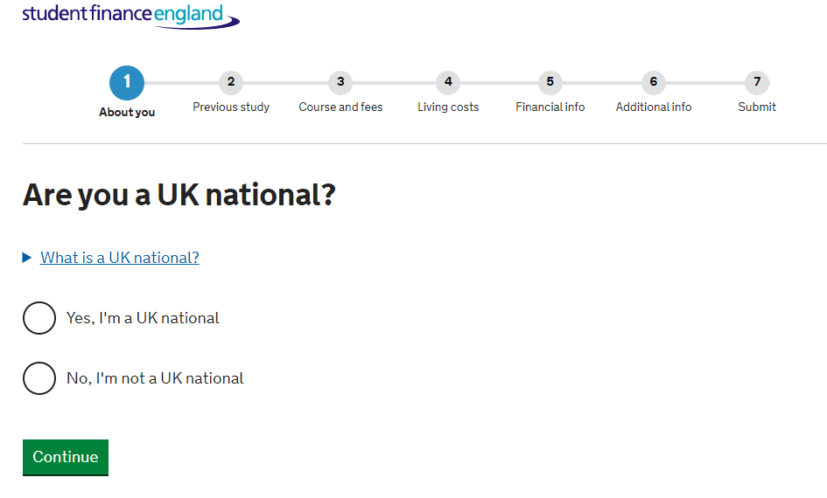

You need to:
Apply online - www.gov.uk/student-finance
Apply even if you have not made your decisions on UCAS
Household income is assessed based on previous tax year
Link to UCAS application
Make sure to tick the box to share information with your university
You need to put in your details to fill in household income (P50/p45)
REMEMBER TO REAPPLY EVERY YEAR!
Keep account of your CRN/passwords
How to apply

Slide 33
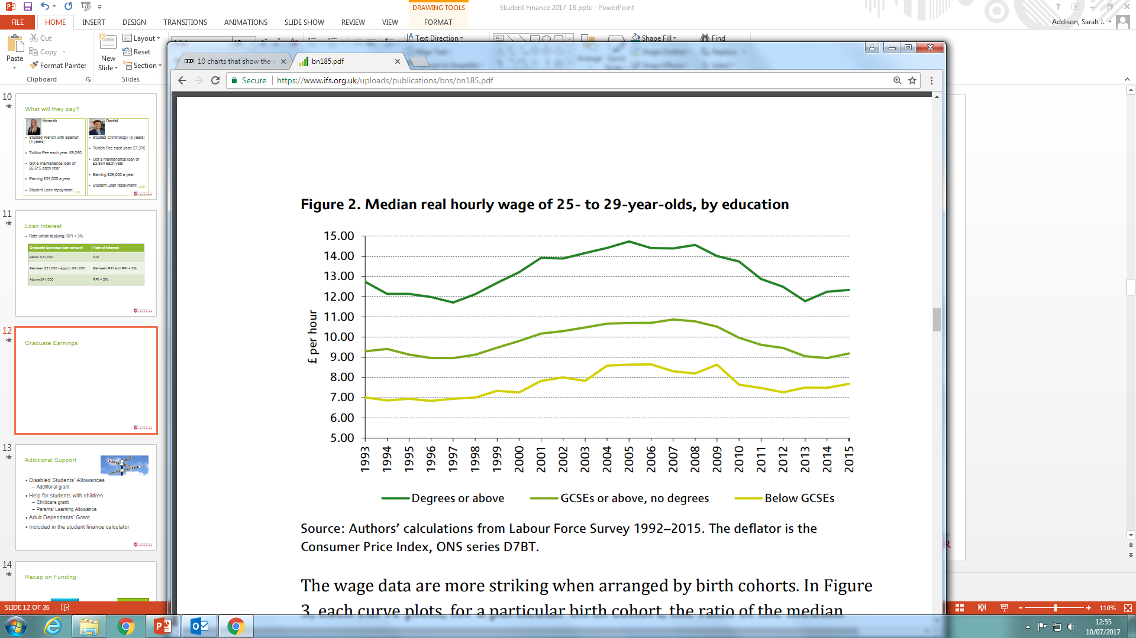
Is getting a degree worth it?

Slide 34
Bursaries, Scholarships and Grants

Slide 35


Citizens of
Change 100
To change 100 lives, supporting the themes of mental health, homelessness and food poverty
60 second video
50x £2,500 cash award
ugscholarships@le.ac.uk

Slide 36
Other Scholarships
Mature Student Scholarship
£3000
University of Leicester Scholarship
£1000
Sports Scholarships
£5000-£500
Music and Choral Scholarships
£1000-£500
Scholarships
https://le.ac.uk/study/undergraduates/fees-funding/scholarships-and-discounts

Slide 37

Weird and wonderful grants!
Grants
Vegetarian Charity Grant: maximum award: £500
The Vegetarian Charity will provide a one-off award of up to £500 for a student in financial need, as long as they promise not to eat any meat.
Leverhulme Trust Undergraduate Bursary: maximum award: £9,000
The Leverhulme Trade Charities Trust offers bursaries of up to £3,000 a year to UK students who are the son, daughter, spouse, widow or widower of a grocer – or indeed a chemist or travelling salesman – and are in need of financial support.
Desmond Tutu Scholarship: maximum award: £24,000 (5 available)
The Desmond Tutu Scholarship offers up to £8,000 per year for students in financial need who are committed to helping the developing world. Applicants must submit a statement showing their proven dedication and "a strong desire to develop skills that, on graduation, they can apply in practical ways to build better futures for disadvantaged peoples around the world".

Slide 38
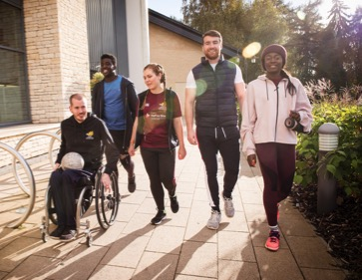


Summary
Remember to apply early for Student Finance
There are lots of sources of money available to you to support your studies
Think about supplementing your income
Getting a degree is definitely worth it!

Slide 39
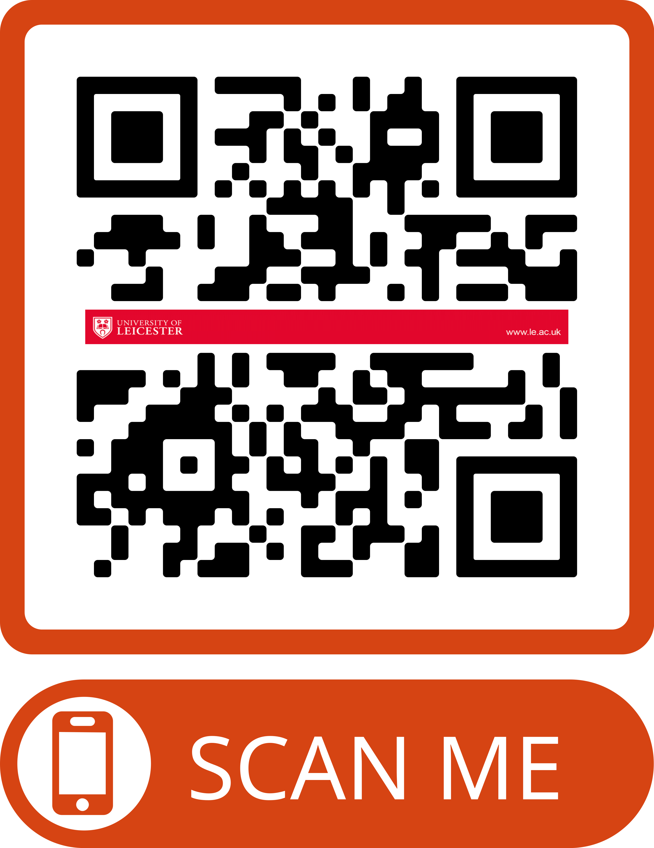
Thank you for listening.
Any questions?
www.le.ac.uk/chat

