Slide 1
Higher Education Interview Training Sessions
Key information:
These begin on Wednesday 23rd June 2021
The venue: SFC2
The sessions run every Wednesday between 3.45 and 4.30
There will be a session every Wednesday between now and 1st December 2021
The sessions are open to anyone who is applying to a university or other form of higher education which carries out interviews as part of its admissions procedure
Please email neil.gatland@bourne-grammar.lincs.sch.uk to notify him of your attendance.

Slide 2
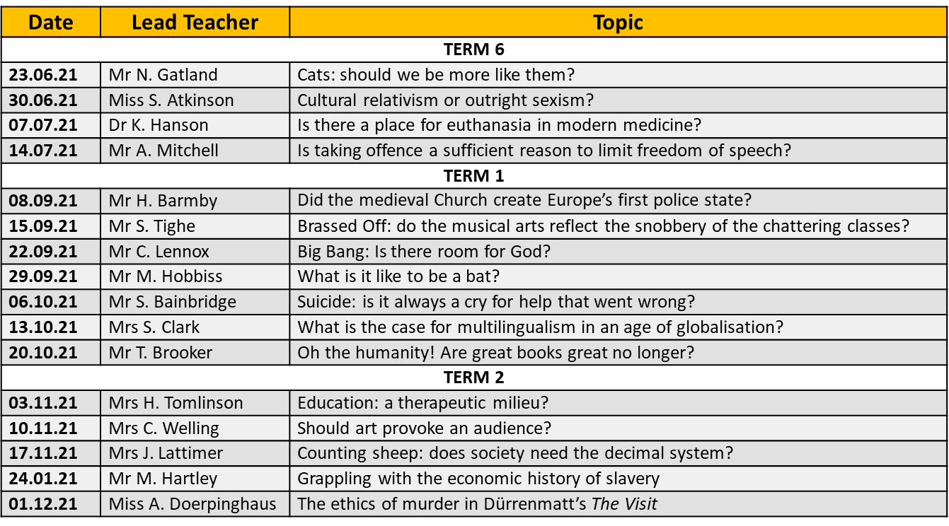
Higher Education Interview Training Sessions

