Slide 1
Post 18 Launch 26 March 2024

Slide 2
Post 18 launch – what’s coming up
This morning
Overview of the UCAS and apprenticeships
Personal statement talk by University of Nottingham
Take notes
Tomorrow P4 and P5
Talk by former BGS students on range of post 18 options
Session on how to use resources to put in a strong application

Slide 3
UCAS – the basics
UCAS: centralised electronic system (www.ucas.com )
You may select a maximum of 5 university courses: not ranked, ‘blind’ application
If applying for medicine or other clinical courses limited to 4 choices plus an alternative (e.g. biomedical science, anatomy)
You can only apply to Oxford or Cambridge
You can choose deferred entry to September 2026 – check course allows this
You can do other applications alongside your UCAS e.g. international, art foundation, apprenticeships
If you are thinking about applying for an apprenticeship have UCAS as a back-up so keep on listening!

Slide 4
Timeline
You create a UCAS account in the Summer Term
You need to write a personal statement to convince admissions tutors to offer you a place. Deadline for first draft is the end of the Summer Term
You add 5 choices taking into account your predicted grades and complete the form
Key deadlines:
Conservatoires: early October deadlines
Early applicants – Oxbridge, medicine, dentistry, veterinary 15 October. There will be an internal deadline in early October.
Main UCAS deadline – last Wednesday in January- BUT there will be an internal deadline in early December
You wait for offers and then narrow your 5 down to a final Firm and Insurance in Spring of Year 13.

Slide 5
What’s on the form?
Reference & Predicted Grades

Slide 6
Will you get an offer?
A-Level predicted grades, may be specific subject requirements
GCSE grades –may be subject/grade requirements
Personal statement – more to come
Admissions tests (UCAT, LNAT etc)
Interview
Work experience
Offer may be in grades or tariff points

Slide 7
UCAS POINTS
UCAS points/Tariff equivalents
Grade | A Level | EPQ
A* | 56 | 28
A | 48 | 24
B | 40 | 20
C | 32 | 16
D | 24 | 12
E | 16 | 8
You can also gain points from Music and Drama exams see https://www.ucas.com/ucas/tariff-calculator

Slide 8
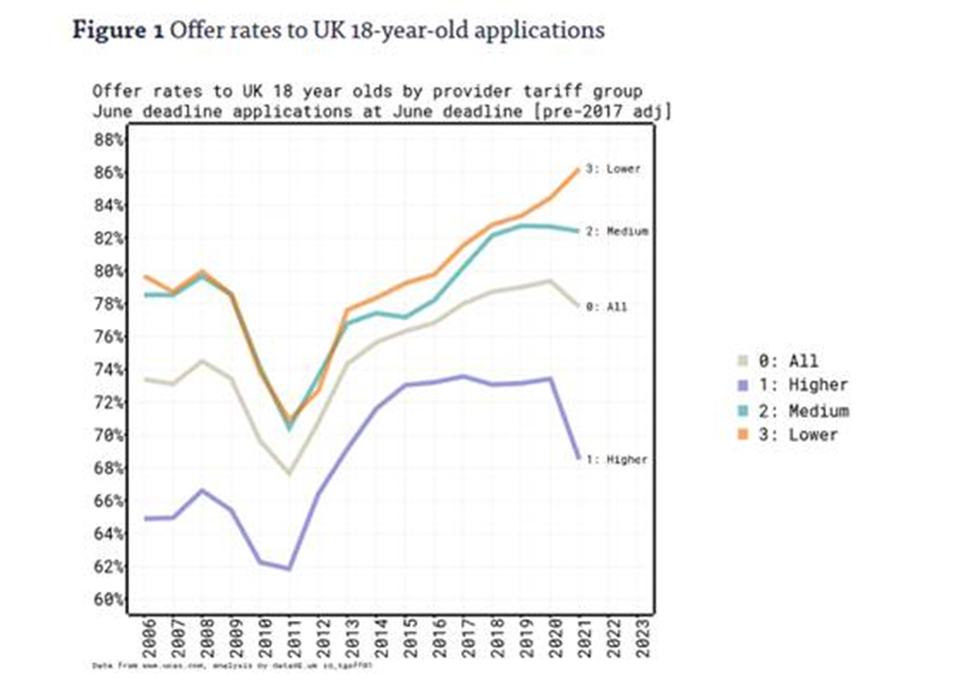
The Higher Education landscape

Slide 9
What does this mean?
Competition for places at very selective universities is tough!
Having the right predicted grades is not a guarantee of an offer
Important to spread risk – particularly competitive at Oxbridge, Durham, LSE, Imperial, Warwick, UCL, St Andrews, Edinburgh, Manchester, Leeds
Particular pressure on Computer science, Economics, Healthcare courses
We suggest a strategy of a spread of entry grades – look at predicted grades when deciding where to apply.
Are you eligible for a contextual offer scheme? Eg Newcastle Partners, Access to Leeds

Slide 11
Choosing the right place
Style – from traditional, with a focus on subject-based courses and research, to modern universities/colleges, with a greater focus on vocational courses.
Location – some are in large cities, others in small towns, by the coast or in the countryside – it’s all a major influence on the environment and lifestyle.
Size – larger universities can have more than 20,000 students, whereas some of the smallest have only a few thousand.
Culture and facilities – influenced by a range of factors, look at the academic and extra-curricular facilities

Slide 12
Choosing the right place (cont)
What graduates do – all universities collect destination statistics; it can be useful to find out what jobs or further study students go on to.
Tuition fees – can vary between universities and colleges; check if there are scholarships or bursaries available.
Living costs – accommodation, transport, and food can vary enormously.

Slide 13
Choosing the right course
What does the course cover? Courses with the same title may be very different.
Look carefully at the core course content, and the range of optional studies/modules available.
Which modules are the most interesting and relevant to your career aspirations?
See if the course or university/college offers any internship, placement, or study abroad opportunities.

Slide 14
Choosing the right course
How is the course taught – structured teaching, or more independent research? How many lectures are there, and how much group work will be done in seminars?
How is the course assessed?
Foundation years – check eligibility

Slide 15
RUSSELL GROUP
‘Typical’ offer A*AA or AAA at A Level
Not the be-all and end-all!
There are many good universities which are not members of the Russell group
Some universities have specialisms in vocational courses

Slide 19
Careers meeting booking system
You can book a careers meeting from the school launchpad
It looks at Mrs Elliot’s diary not yours!
Book 2 consecutive appointments if needed

Slide 20
Check your emails daily

