Slide 1
PERSONAL STATEMENTS
Charlotte Barratt
widening participation officer

Slide 2
Match the facts with the figures
Number of characters allowed in a personal statement.
Number of lines allowed in a personal statement.
Number of times this quote was used for a personal statement in 2015: ‘For as long as I can remember I have…’
Number of times this was the opening sentence of a personal statement in 2010: ‘I am currently studying a BTEC National Diploma in ...’
Number of people who applied to UCAS in 2015.
Overall acceptance rate in 2015 (%).
Number of HE institutions in the UK.
Percentage of female applicants in 2015.
Date in January of UCAS deadlines.
4000
47
1,451
464
718,500
74.1
300
57.9
15
718,500 74.1 464 4000 300 15 1,451 47 57.9

Slide 3
Personal Statements – The Basics
All applications are done online
4,000 character limit
One personal statement for all applications
Information on applying at www.ucas.com
Purpose is to convince an admissions tutor to make you an offer
to study one of their courses

Slide 4
Personal Statements: do they matter?
Vital for some courses
Important for others
Relevant at the margin for others
Always just one part of the selection process

Slide 5

What are Admissions Tutors Looking for?
A clear, well written UCAS
application form
Why you want to study the course
A deeper understanding of the
course and what studying it entails
What you hope to get out of it
Enthusiasm
Work Experience, Volunteer Work
Extra-curricular activities

Slide 6

A Suggested Structure
Five or six fairly equal paragraphs
Two core sections:
  Why do you want to do this course?
  Demonstrate that you would be a good student on that course
Plan it as you would plan an assignment

Slide 7
Part 1: Why do you want to study ________?
Explain why you really want to do the course
  Inspiration, passion, motivation
  Career goal? Academic goal?
Try not to be too cliché
Try not to state the obvious!
  “I want to study Medicine because I want to be a doctor and help people...”

Slide 8
Part 2: Demonstrate you will be a good student
This should form the majority of your personal statement
Show your deeper understanding of the subject
Demonstrate your skills, experiences and abilities that are relevant to that degree

Slide 9
Understanding the subject
Learn everything you can about the course
  Length of study
  Detailed course content
  Teaching methods
  Style of assessment
  Professional routes/accreditation

Slide 10

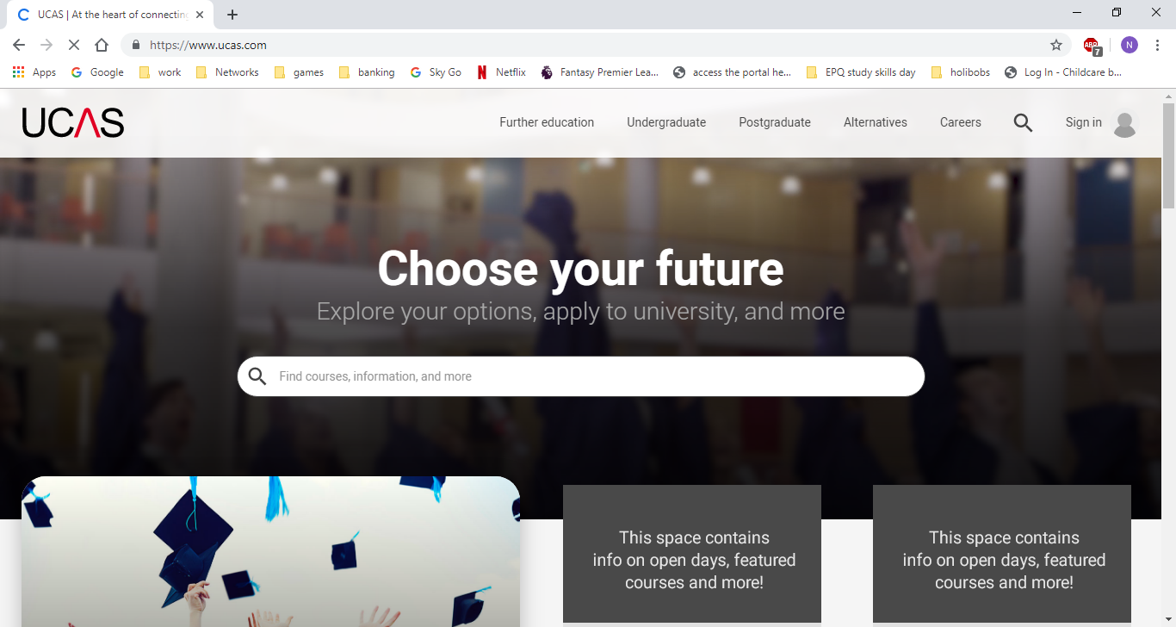



Understanding the subject – information sources

Slide 11

Engineering, University of Leicester
You will carry out a multidisciplinary team project, highlighting the need for engineers from different fields to work closely with each other towards a common goal.

Slide 12

Law, University of Bristol
You'll need to be interested in, and committed to, the study of Law. Have you tried to find out more about the subject by reading relevant texts? It might be an idea to visit courts, undertake a work placement with a practising lawyer, and talk to lawyers - it will help you to decide if studying law is for you.
In order to succeed on the course you will need to be able to think clearly. Do you enjoy thinking of potential solutions to problems? Are you willing to see things from different perspectives, and not just look for an easy answer?
Do you enjoy presenting arguments? Do you like to debate with others? You should be willing to listen to others’ opinions, but not be afraid to assert your own position.

Slide 13

Dentistry, University of Birmingham
Dentistry is not only academically demanding but also technically exacting. Some indication of practical ability is important for prospective dental students. This is often in the form of musical ability or art (drawing, painting, sculpture etc.), needlework, model making, or anything which shows the ability of hand to eye co-ordination.
It would be an advantage to demonstrate this ability in discussion with staff at interview by bringing a small selection of work to interview or indicating musical ability in your UCAS personal statement.

Slide 14

LSE, History
Before you write your personal statement, please visit our online course guides … For example, students applying to History at Cambridge can choose to study Ancient History as part of their degree. However the History course at LSE does not offer any Ancient History units. If the Admissions Tutor reads a personal statement which includes information on an applicant’s interest in Ancient History, they will not make the applicant an offer as it does not show evidence of interest in the particular course that is offered at LSE, which focuses on International History.

Slide 15
Demonstrate you will be a good student
Understand the subject and identify key skills and attributes needed
Think about how you can demonstrate that you have these skills
Explain how these skills will help you on the course
Make sure that everything you write about is relevant to the course you are applying to

Slide 16
Demonstrate you will be a good student
Where do these skills experiences come from?
  Academic work (in and out of school)
  Extra curricular activities
  Work experience/employment
  Hobbies and interests
  Other experiences
Seek specific advice for Oxbridge applications
  Academic focus

Slide 17

Notes:
Engine analogy – putting everything together in the correct way. Like a car engine if you take it a part you have lots of good parts but don’t do anything by themselves but when added together they create something that works. Just like a personal statement.

Slide 18
11 most common opening lines in UCAS personal statements
From a young age I have (always) been [interested in/fascinated by]
For as long as I can remember I have…
I am applying for this course because…
I have always been interested in…
Throughout my life I have always enjoyed…
Reflecting on my educational experiences…
1779
1451
1370
927
310
257
Source: UCAS.com – top opening statements from 2015 application cycle

Slide 19

11 most common opening lines in UCAS personal statements
Nursing is a very challenging and demanding [career/profession/course]…
Academically, I have always been…
I have always wanted to pursue a career in…
I have always been passionate about…
Education is the most powerful weapon which you can use to change the world…
211
168
160
160
148

Slide 20
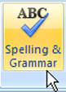
Please remember….
Check it before you submit it (spelling and grammar)

Slide 21

Avoid…
Defining the subject
Overselling your enthusiasm
  Being too quirky
  Conscientious, not wacky!
Embroidering the truth / copying (aka plagiarism)
  Copycatch similarity detection system

Slide 22
Genuine proofreading examples
“…I am working with a software developer on an application to be used in hospitals
(Do I need to talk about this job? It’s quite technical could I talk about that?)”
“…and played for the XXXX Junior American Football team. (is all this cr*p relevant or not?) (Should I mention I was head pupil in Yr 9?)”

Slide 23

Language
Keep it simple
Common and easy to understand English
Absolutely no slang / txt spk
Don’t try to come across as a leading academic in your field
Be confident and assertive
  “I think I would make a fairly good student because…”
  vs
  “I will make a good student because…”

Slide 24

Notes:
‘Your chance to be the judges’

Slide 25
MANAGEMENT STUDIES
“Having been a Nottingham Forest supporter for the majority of my life, I have always wondered how such an illustrious club full of history has not played top-flight football for the best part of ten years and are now currently in the lower regions of the football league. It could well be the fact that past managers making poor decisions has resulted in Forest's failure, in an attempt to bring back the glory years under the leadership of the great Brian Clough. This is where my fascination for management began. Having studied Business Studies since GCSE level, my interest of the subject has been extended to A-level.
My love for sport, particularly football, is backed up by being selected for the 6th form 1st team at left back. I also play football outside school, having played for my local football team, Great Gonerby Youth Football club, from 2002 to 2006. I currently play for a team close to where my father lives, Southwell City under 18's. Playing for a football team has made me realise how important it is to be able to work in a team and to be able to communicate well with others. This also provides me a welcome break from my academic studies.”

Slide 26
HISTORY
“..out of the darkness loomed the silent majesty of the Forum. A bit cheesy I know but I wanted to convey the excitement I felt on visiting Rome. That first evening, I walked the Appian Way and there stood the Forum. It was real! For the last 5 years or so, I have had a fascination for the Roman Empire and especially for its military history. I have often pondered on how the political map of today has been set by the decisions military leaders took on the battlefield a thousand years ago.”

Slide 27
CRIMINOLOGY
“From watching and reading Sherlock Holmes, Cracker, CSI and Crime watch, my interest in criminology has developed. Criminology has always had a glamorous image but it is more than that it deals with criminals and supports the justice system. Criminology is all about crime and punishment. It is an exciting inter-disciplinary subject which draws on Sociology, Psychology and Law to help examine how crime is defined, why people commit crimes, and how society responds to crimes.”

Slide 28
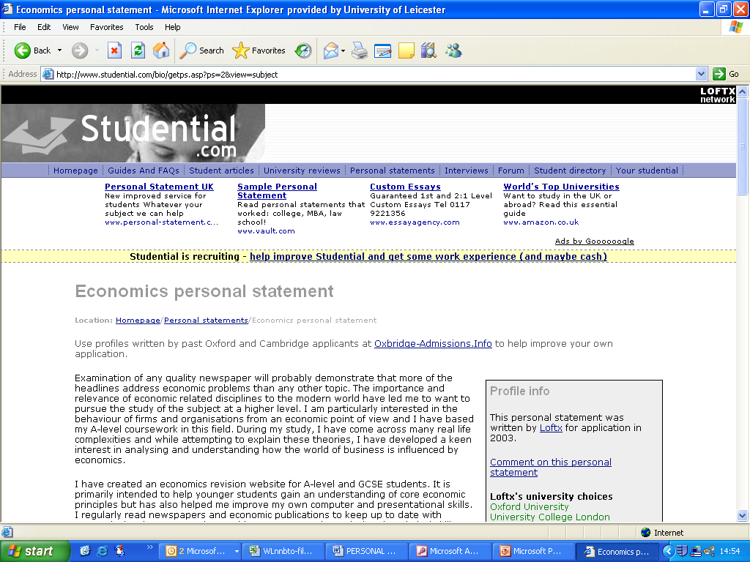
economics
“Examination of any quality newspaper will probably demonstrate that more of the headlines address economic problems than any other topic. The importance and relevance of economics and related disciplines to the modern have led me to want to pursue the study of the subject at a higher level. I am particularly interested in the behavior of firms and organizations from an economic standpoint. During my study, I have come across many real life complexities and, while attempting to apply theoretical ideas, I have developed a keen interest in analyzing and understanding how the world of business is influenced by economics.”

Slide 29

THANKYOU FOR LISTENING
Any questions?

